Slide 1
Financial Independence
During Difficult Time

Slide 2
Middle Income American Families Situation
Credit card,
Mortgage,
Car loan
Pay Debt
25%
Debt
50%
House Hold
Expenses
$Savings
25%
Taxes
Uncle Sam
Reduce Tax Liabilities

Slide 3
What do Middle Income American Families Need?
College
Academic
Financial

Slide 4
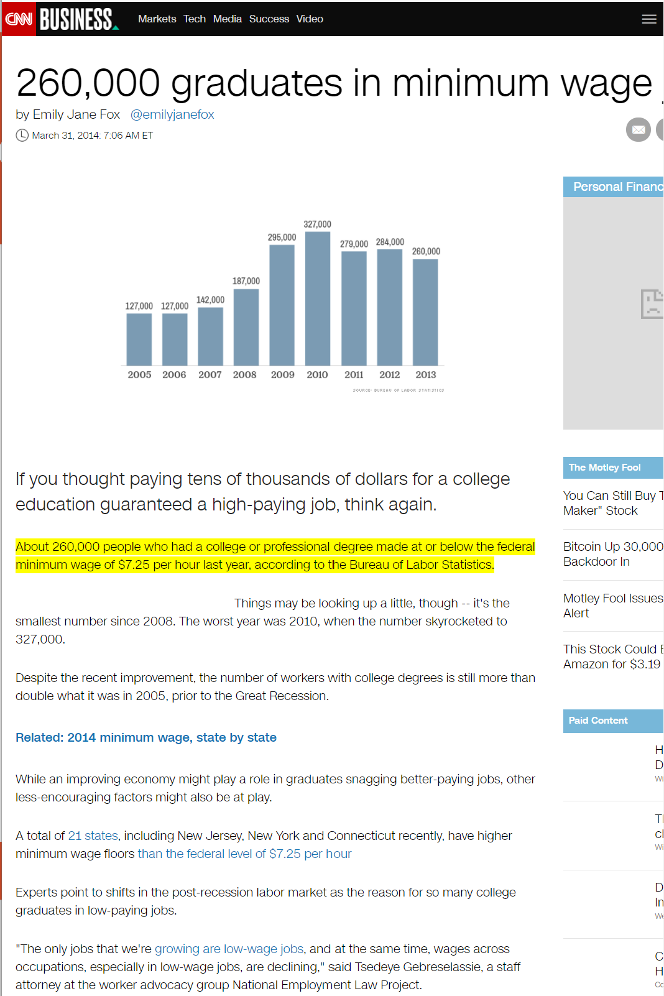

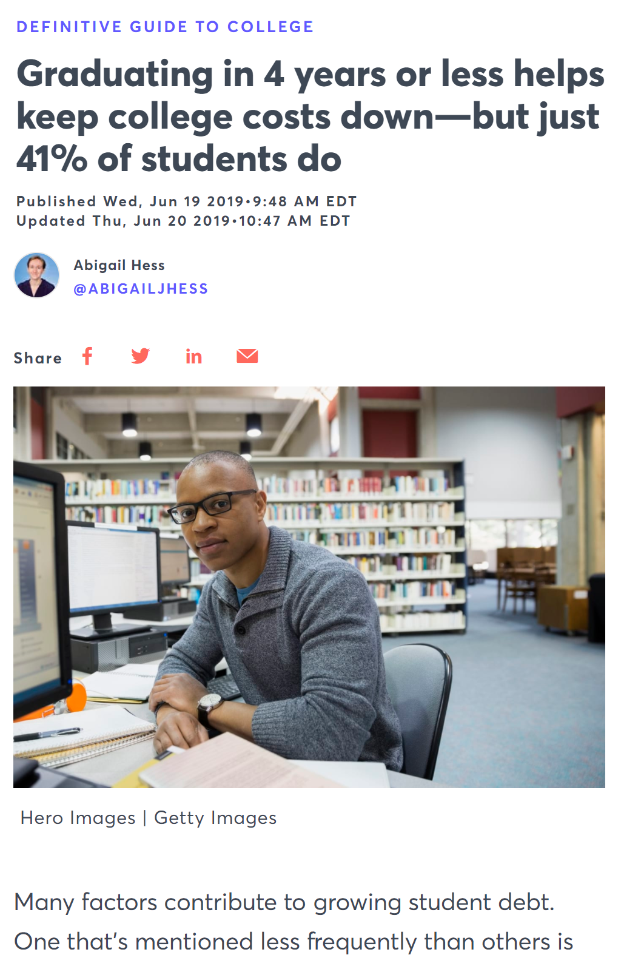
Challenges with College - Academic
About 260,000 people who had a college or professional degree made at or below the federal minimum wage of $7.25 per hour last year, according to the Bureau of Labor Statistics.

Slide 5

Heartland – Our Partner

Slide 6

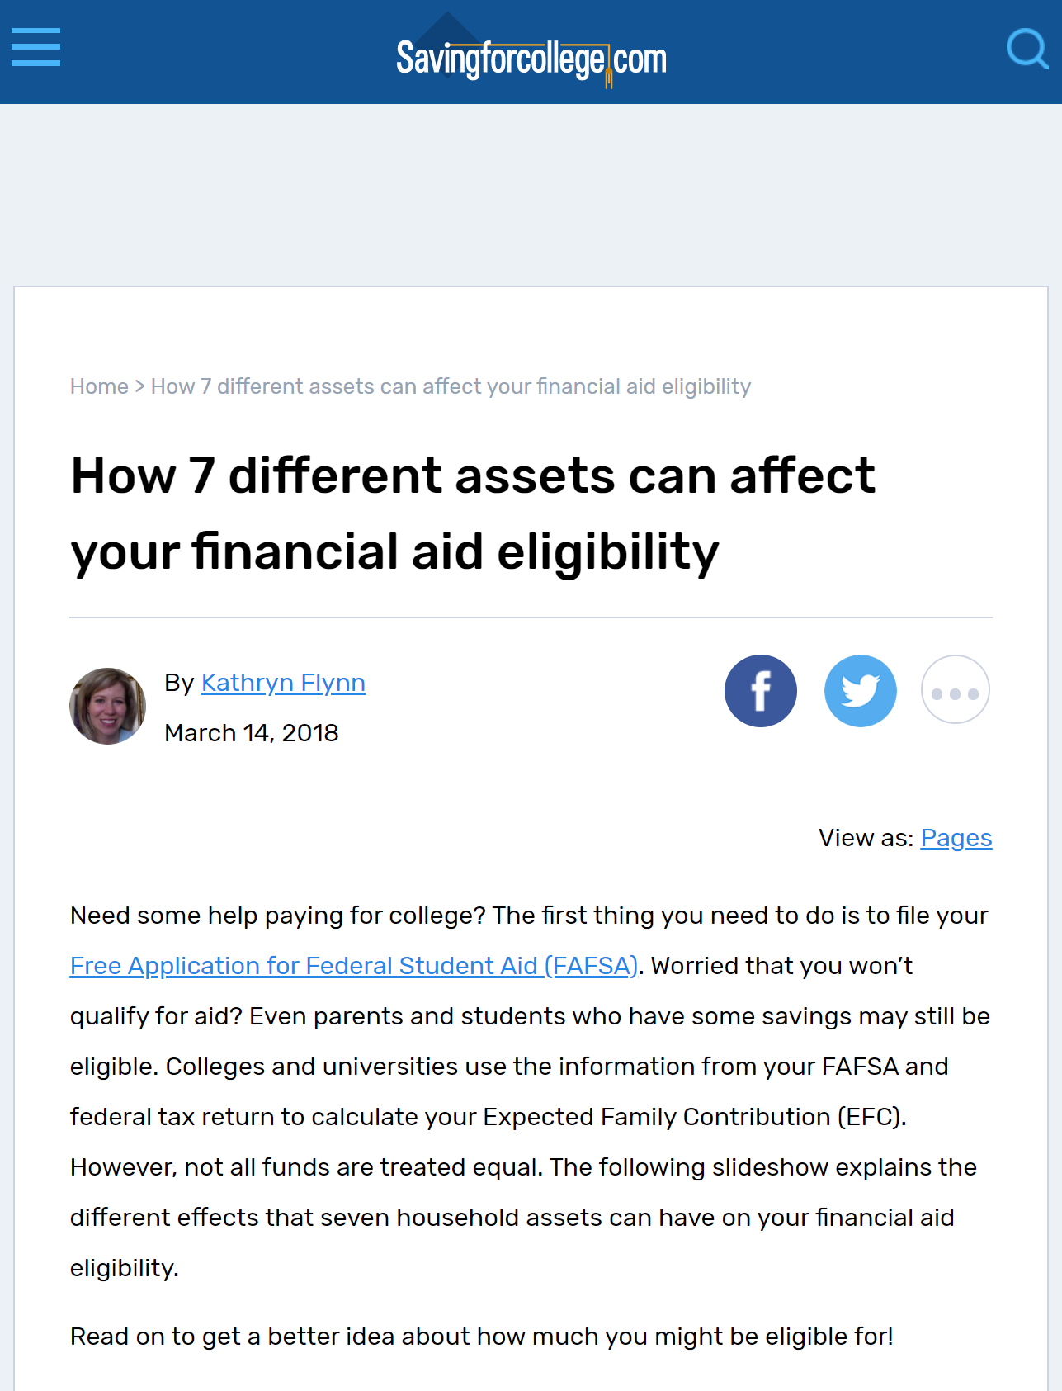

Challenges with College - Financial

Slide 7
What do Middle Income American Families Need?
College
Academic
Financial
Early Career
Savings Habit
Investment

Slide 8




Are You A Creature of Habit?
Clasp your hands together – which thumb is on top?
Cross your arms – which arm is on top?
Ladies – from which side of your mouth do you apply lipstick?
Men – from which side of your face do you start shaving?

Slide 9

Saving is a Habit, and so is Spending

Slide 10
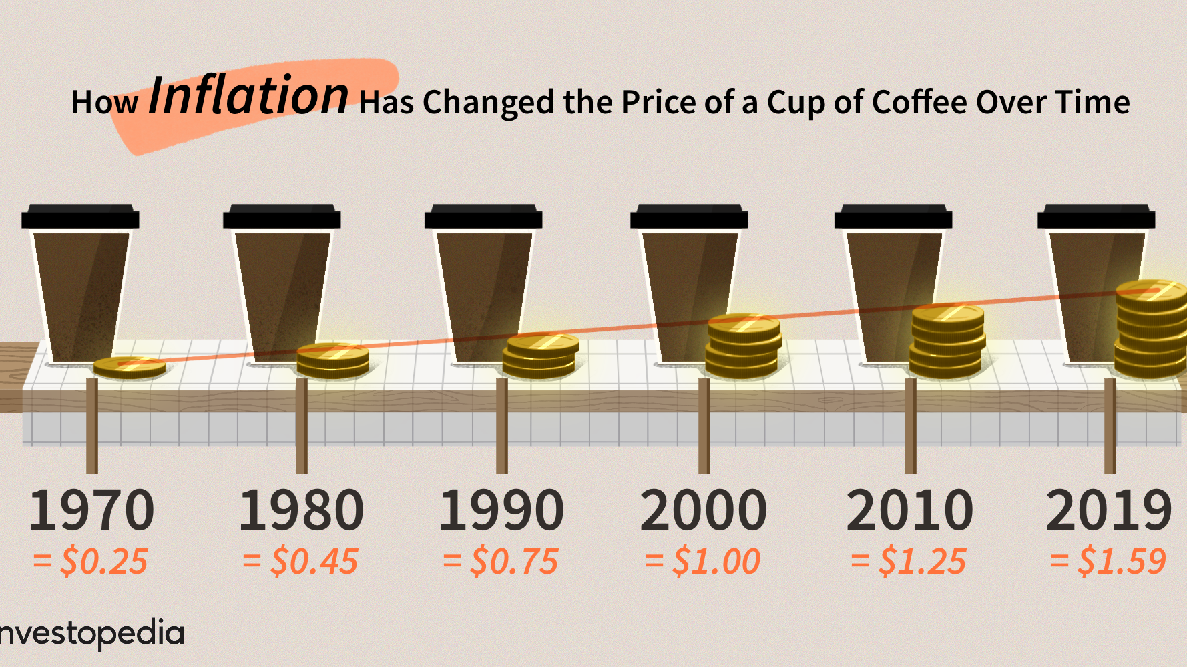
Saving and Investing - Inflation
3.5%

Slide 11
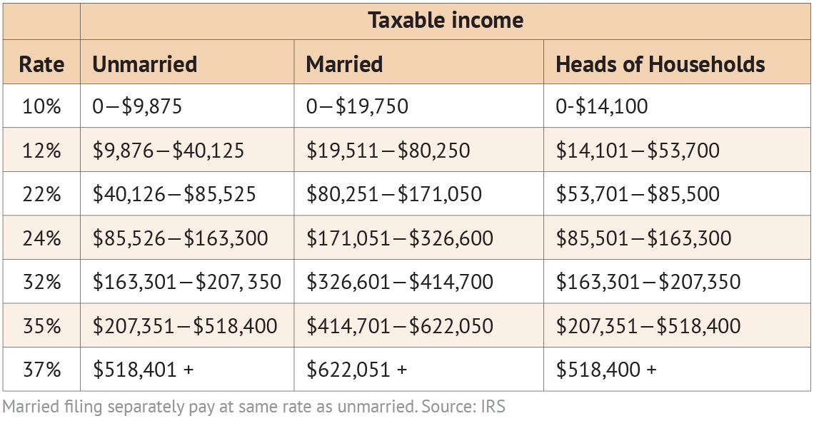
Saving and Investing - Taxes
22%
4.95%
------+
26.95%
Illinois State Tax: 4.95%

Slide 12
How Much Do I Need to Gain?
Save | $100
Interest (5%)
Total
Taxes (26.95%)
Net
Inflation (3.5%)
Real Return
+ $5
$105
- $1.3475
$103.65
- $3.628
$100.02

Slide 13
Do You Know the Different Tax Categories
IN THE U.S.
TAX NOW
TAX LATER
TAX ADVANTAGED
Checking
Savings
CD
Stock
Mutual Fund
401(k)/403(b)/
457
IRA/SEP-IRA
Annuity
Pension
Roth-IRA
529 College Savings/
Coverdell
Municipal BOND
Health Savings Acc. (HSA)
CASH VALUE LIFE INSURANCE
Long Term Care BENEFIT

Slide 14
Reduce the Impact of Taxes
TAXABLE (Tax Now)
- Savings Accounts
- Certificates of Deposit
TAX DEFERRED (Tax Later)
- 401(k)s - Fixed Annuities
- IRAs - Savings Bonds
TAX ADVANTAGED
- Roth IRAs
- Cash Accumulation in a
Life Insurance Policy

Slide 15
Do You Know the Different Tax Categories In The US
Tax Now
Tax Deferred/Later
Tax Advantage
Checking
Savings
CD
Stock
Mutual Fund
401(k)/403(b)/
457
IRA/SEP-IRA
Annuity
Pension
Roth-IRA
529 College Savings/
Coverdell
Municipal BOND
Health Savings Acc. (HSA)
CASH VALUE LIFE INSURANCE
Long Term Care BENEFIT
No
Tax
59½
Fed 22%
State (IL) 5%
Penalty 10%
Required
Minimum
Distribution
59½
70½

Slide 16
What do Middle Income American Families Need?
College
Academic
Financial
Early Career
Savings Habit
Investment
Young Family
Protect Income

Slide 17






The X-Curve Concept
Responsibilities
Wealth
Build our wealth &
Reduce Responsibilities
Different priority,
not protecting income
but our future
INCOME
More
secure
- Job Loss
- Sick or Disable
- Permanently Disable
- Die soon
- Longevity
- Health Care / LTC
- Legacy / Estate planning
Family financial may collapse
Need to protect our INCOME

Slide 18
What do Middle Income American Families Need?
College
Academic
Financial
Early Career
Savings Habit
Investment
Young Family
Protect Income
Mature Family
Retirement Planning

Slide 19
How Much do We Need For Retirement
$1,000,000
20 years
x $50,000 =
65
85
86
87

Slide 20
What do Middle Income American Families Need?
College
Academic
Financial
Early Career
Savings Habit
Investment
Young Family
Protect Income
Mature Family
Retirement Planning
Retirement Phase
Longevity
Health Care
Long Term Care

Slide 21
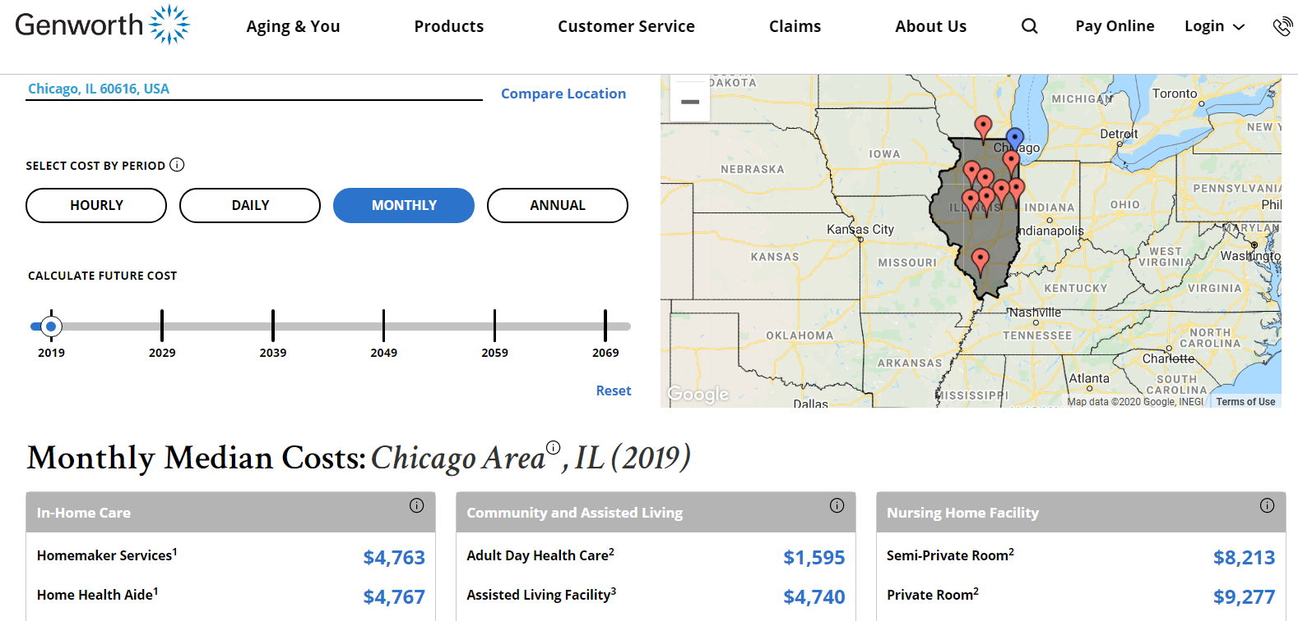
Cost of Long Term Care

Slide 22
What do Middle Income American Families Need?
College
Academic
Financial
Early Career
Savings Habit
Investment
Young Family
Protect Income
Mature Family
Retirement Planning
Retirement Phase
Longevity
Health Care
Long Term Care
Die
Estate Planning
Final Expense

Slide 23
Estate Planning
Will |  | To ensure my property will go to whom I choose when I die. Name Legal Guardian for Young Children
Trust |  | Avoid Probate => Expensive => 18 months Assign Successor Trustee(s) for Young Children
Advance Healthcare Directive |  | I don’t want to burden my family to have to try to make decisions for me
Power of Attorney |  | Trusted person to manage my accounts and finances if I’m unable to.

Slide 24
What do Middle Income American Families Need?
College
Academic
Financial
Early Career
Savings Habit
Investment
Young Family
Protect Income
Mature Family
Retirement Planning
Retirement Phase
Longevity
Health Care
Long Term Care
Die
Estate Planning
Final Expense

Slide 25
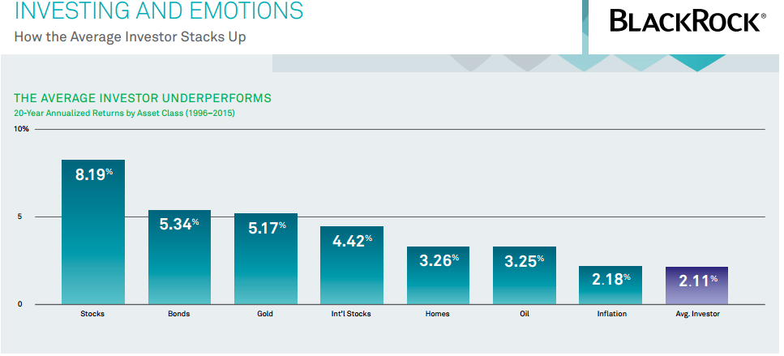

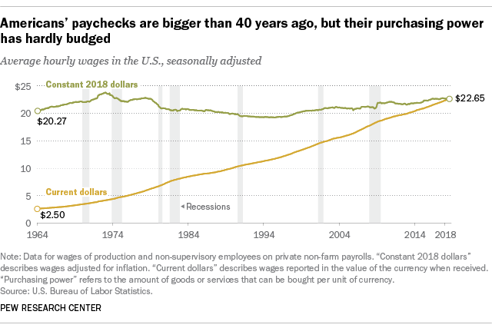
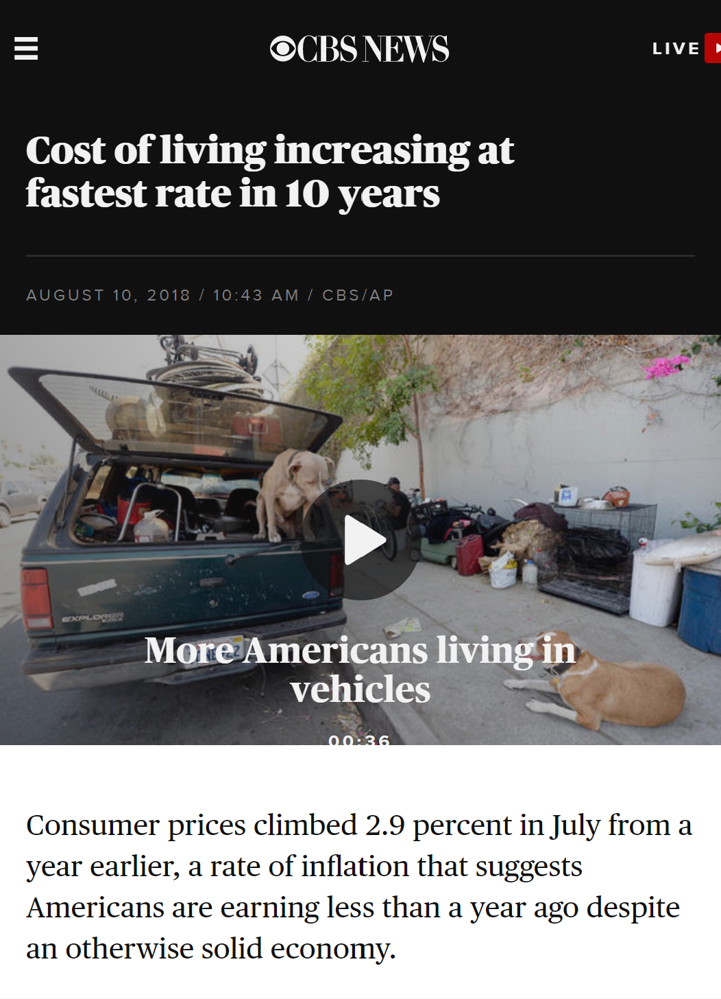
Middle Income American Family Challenge #1:
Not Enough $
High Tax
Slow Salary Raise
Lost $
And after refunds, the IRS collected about $93 billion more from individual American taxpayers than it did in 2017. Interestingly, that number stands close to the tax break amount that corporations received from the TCJA in 2018. Last year, big businesses paid $91 billion less in taxes than they had in 2017, prior to the new law’s passage.
Cost of Living
2.11%
1964
$20.27
2018
$22.65

Slide 26






Middle Income American Family Challenge #2:
$ Demand High
Emergency $
Retirement $$$$
Mortgage $$
Protection $$$
College $$$
Estate
Preservation $$

Slide 27

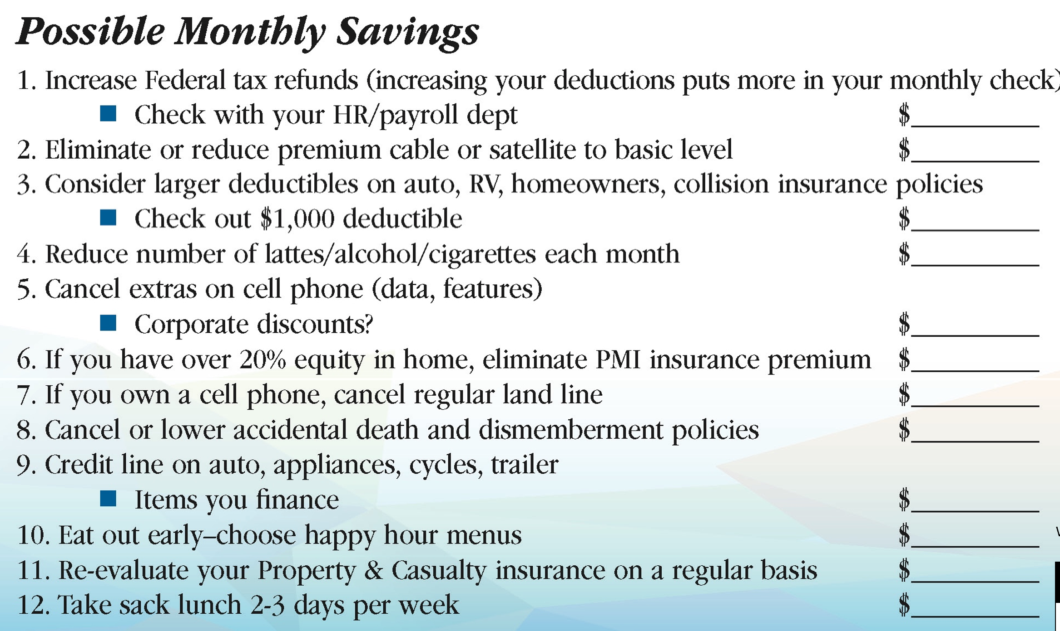

How do I Get Started to Financial Independence?

Slide 28
Build a Strong Financial Foundation
Investment
Debt Mgmt
Protect Income
Emergency Fund

Slide 29
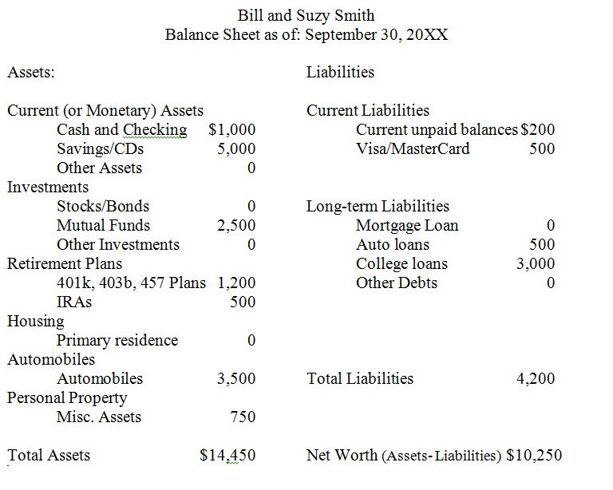

How do I get Started?
Investment
Debt Mgmt
Protect Income
Emergency Fund

Slide 30
Q & A

